Slide 1

An Investigation Into Motor Vehicle Crashes
jimmy dela cRuz
Andrea Kwong
Charlie Lee
Vijaya Tatineni

Slide 2
MOTIVATION
WHY
Americans are driving more than ever. In fact, the Federal Highway Administration reported that 3.2 trillion miles were driven on U.S. roads in 2016.¹ During the same time period, the U.S. recorded vehicle sales of $17.55 million.² With more vehicles on the road, there have been over 37,000 people killed in vehicle crashes in 2016.³

Slide 3
OVERVIEW
OBJECTIVE:
Investigate U.S. motor vehicle accidents in 2016 to better understand the types and causes of these accidents.
HYPOTHESES:
Poor Lighting conditions causes more accidents
Bad Weather causes more accidents
Bad road Infrastructure causes more accidents
More accidents occur on weekends/holidays compared to weekdays

Slide 4
QUESTIONS
LIGHTING CONDITIONS - What causes of accidents from harmful events were associated with Lighting? Is there a relationship between alcohol related crashes and lighting?
TIME OF DAY – What are differences between holidays/weekend vs weekday crashes in relation to the time of day? Are there differences in the number of fatalities & whether alcohol was involved? Which states and counties had the most crashes?
WEATHER – Is there a correlation between weather and the manner of collision? Does bad weather lead to an increased number of accidents?
HARMFUL EVENTS – What types of crashes occur more frequently, and for what age groups? How does this compare to 2015 data?

Slide 5
DATA
PRIMARY SOURCE
The National Highway Traffic & Safety Administration (NTHSA) (https://www.nhtsa.gov/) under the Department of Transportation documents annual fatality data on motor vehicle crashes for all 50 states. Information on the accident, the vehicle, the person(s) involved are provided. We looked at 2016 data for our analysis.
CHALLENGES
Lack of infrastructure data from accidents file
Many CSV files of data
How to strategize and decide what to present

Slide 6
DATA CLEANING
Downloaded relevant csv files for 2016 and 2015 from NHTSA website. (accident and person files)
Used the reference, “Fatality Analysis Reporting System (FARS) Analytical User’s Manual” to understand the columns and the codes associated with each data element.
Created separate csv files for the relevant fields. (codes and values)
Read csv files into dataframes and mapped the values from the codes.
For City and County columns, downloaded a separate XLS file from GSA.gov, created a unique index which was a combination of the state, county, and city and mapped the city and county names.
We deleted duplicates and filled in null spaces.
Created a csv file from cleaned dataframe, which was used for exploration and analysis

Slide 7

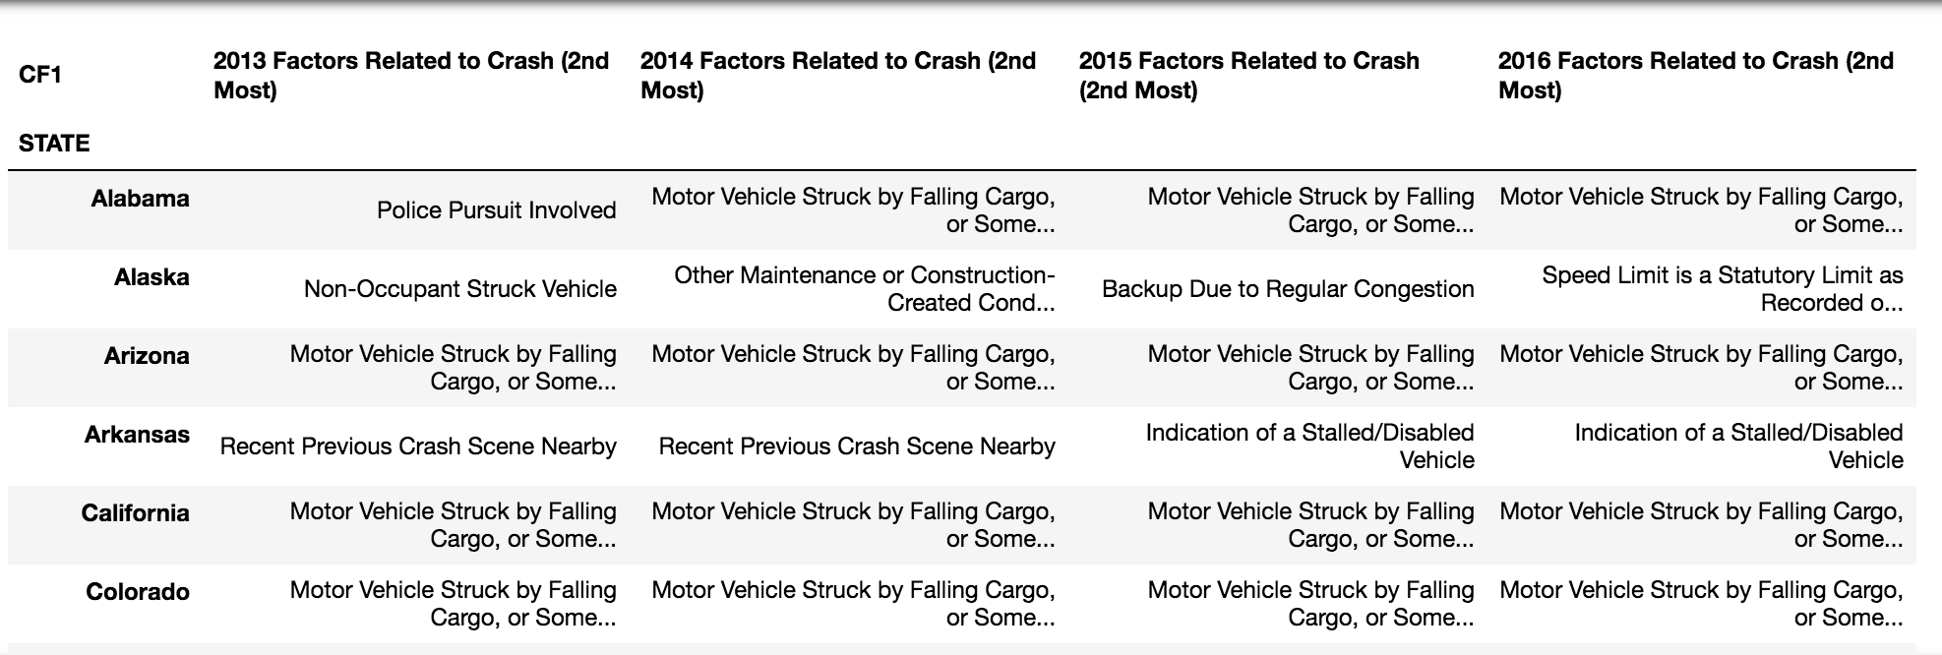
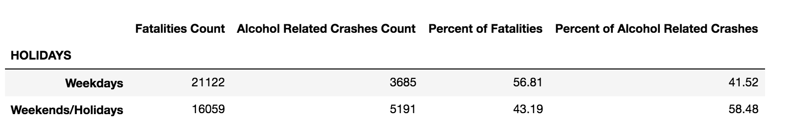
DATA EXPLORATION
Lack of relevant data
One of the columns included factors related to the crash which included infrastructure as reported by the investigating officer. However, over 90% of the data reported no factors related to the crash.
Pivot to another interesting variable
General to granular data

Slide 8

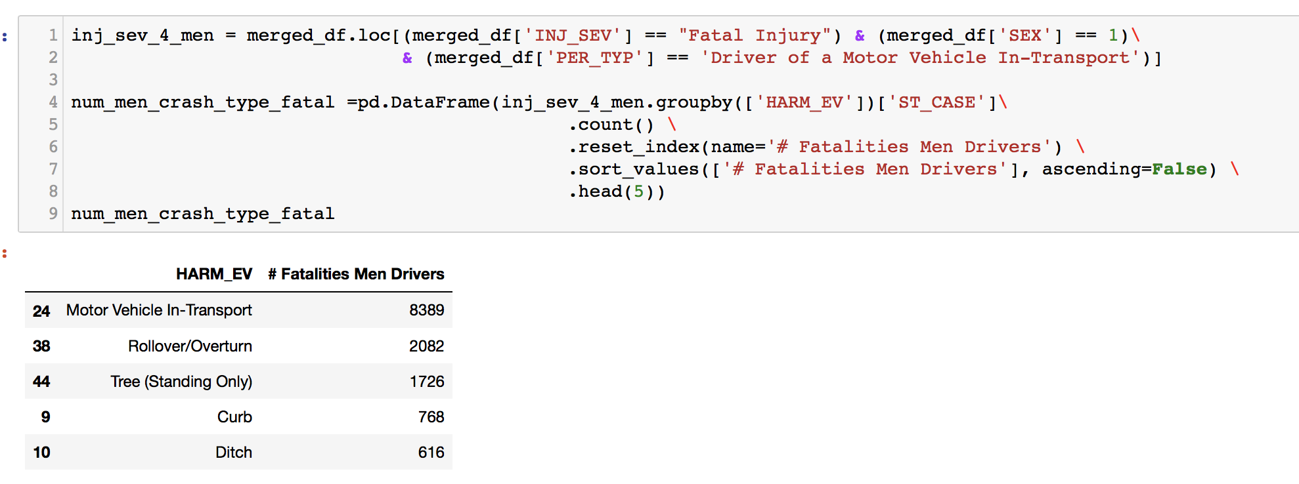



DATA EXPLORATION
Used bins to categorize persons by age
Merging different dataframes
Used loc to subset/slice the data.

Slide 9
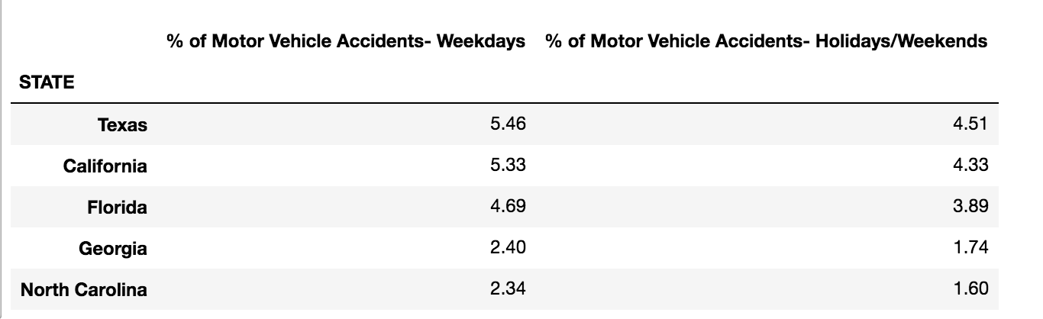
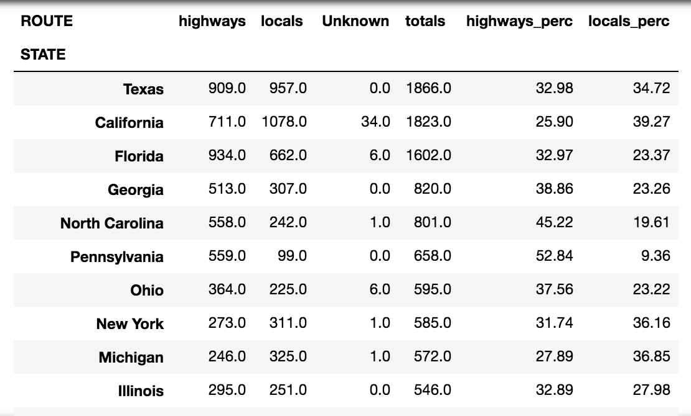
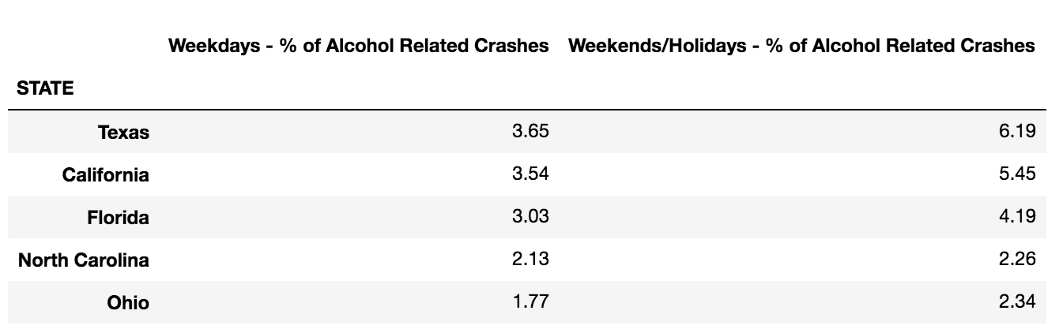
DATA ANALYSIS
% of CRASHES by ROUTE & STATE
% of CRASHES by DAY & STATE
% of ALCOHOL RELATED CRASHES by DAY & STATE
According to US Census Bureau,
Top 5 Highly populated states for 2016 were:
California, Texas, Florida, New York, Illinios

Slide 10
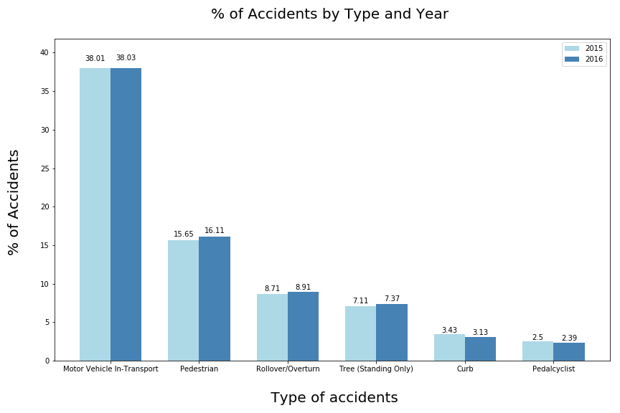
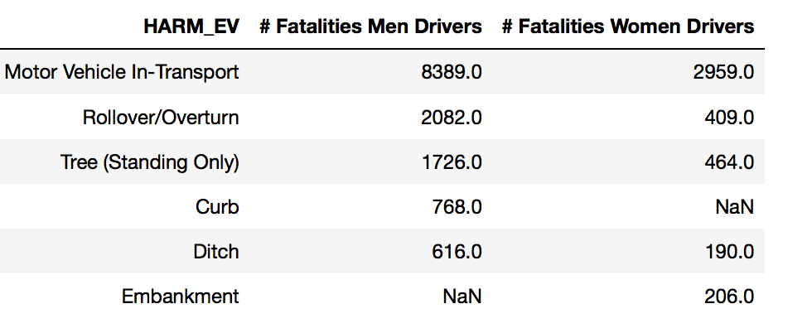
CRASH TYPES
Almost 38% of the accidents resulted in damaging or injuring other motor vehicles that are in motion
Next highest involved injuring a pedestrian
In most of the cases the % of accidents increased in 2016 when compared to 2015

Slide 11
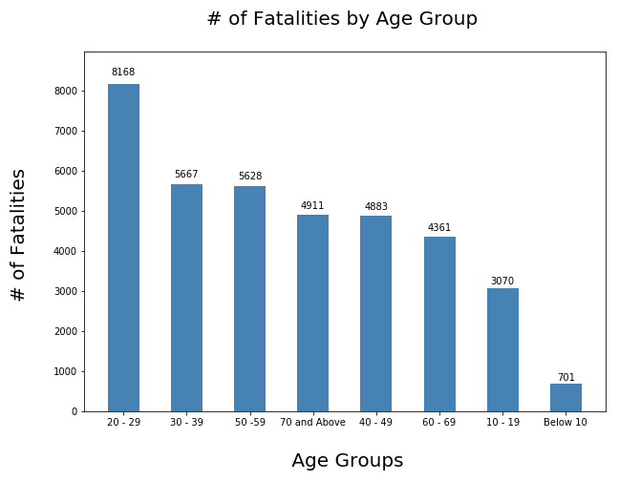
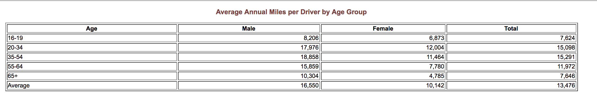
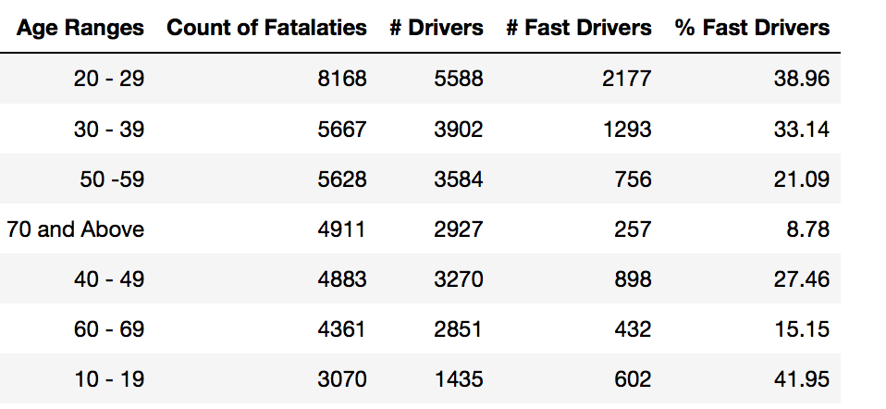
FATALITIES BY AGE
# Fatalities & # Drivers by Age:
Age Groups : 20 -29 clearly topped the list.
Followed by 30 -39 and 50 -59
% of Fast Drivers:
Age Groups : 10 -19 and 20 – 29 clearly topped the list. Followed by 30 -39

Slide 12
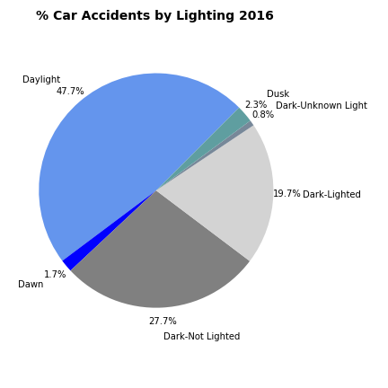
LIGHTING CONDITIONS
Although more people drive in daylight than in the dark, the percentages of accidents are similar.
About 50% more accidents occur during dark–not lighted conditions versus dark–lighted conditions. It is much safer to drive in the light.

Slide 13
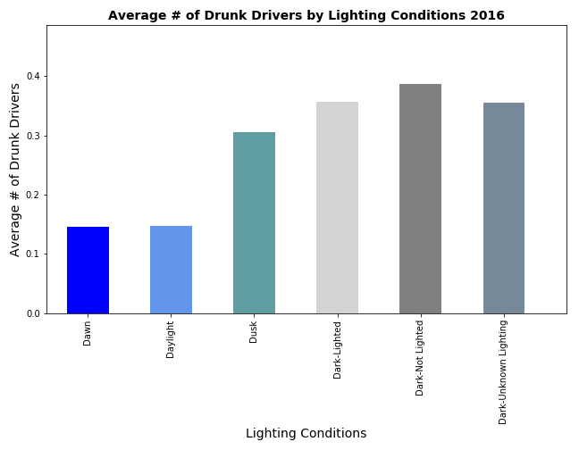
LIGHTING CONDITIONS
The average number of drunk drivers involved in accidents in dark conditions are more than twice the amount in daylight. Drivers should be more careful when driving at night as there is a higher chance of being involved in accidents with drunk drivers.

Slide 14
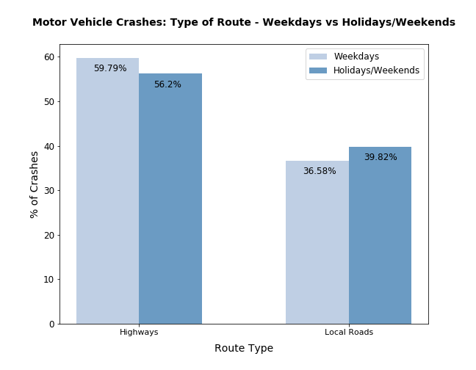
WEEKENDS/HOLIDAYS vs. WEEKDAYS
For both holidays/weekends and weekdays, highways accounted for almost 60% of vehicle crashes.
Local roads accounted for almost 40% of accidents.
Notes:
.

Slide 15
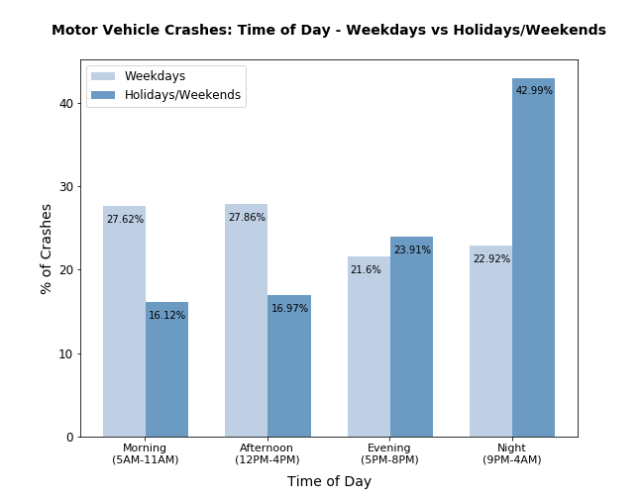
WEEKENDS/HOLIDAYS vs. WEEKDAYS
On weekdays, 56% of vehicle crashes occurred either in the Morning or Afternoon. These times are commuting hours.
43% of vehicle crashes occurred during the Night on holidays/weekends.

Slide 16
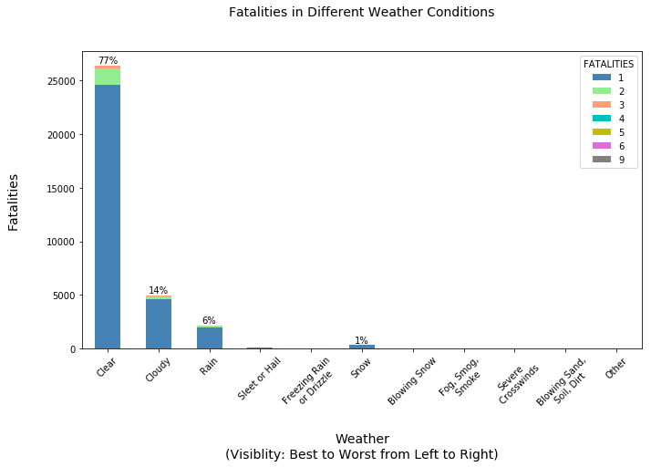
WEATHER
The number of fatalities in good weather is dramatically greater than in bad weather.
People tend to be more careful when driving in bad weather.
People generally drive more when the weather is good.

Slide 17
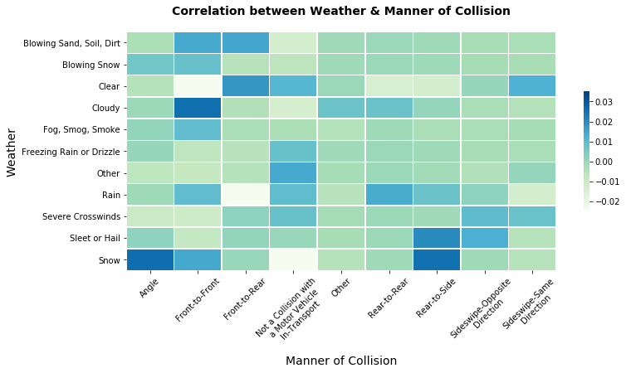
WEATHER
Highest Correlation
Clear: Front-to-Rear
Cloudy: Front-to-Front
Sleet/Hail: Rear-to-Side
Snow: Angle &
Rear-to-Side
Cars can easily skid on icy roads.

Slide 18
CONCLUSIONS
Concerned authorities should invest more in better lighting mechanisms to save lives
More stringent policies on Chained tires on Snowy days
Build better monitoring systems for speed limit violations
Better laws/signs for the safety of pedestrians
FURTHER ANALYSIS
Obtain vehicle information specifically, make year and vehicle type to determine if correlation exists to the number of accidents
Look at safety equipment used to determine if it reduced the number of fatalities

Slide 19


